Slide 1
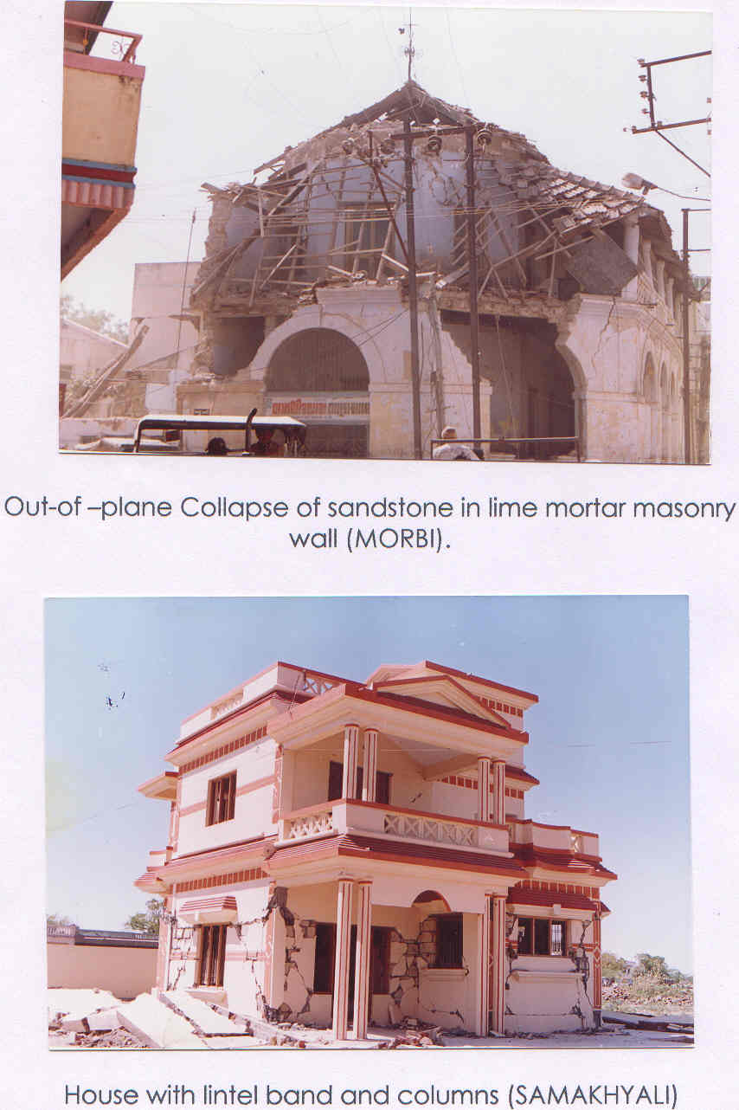
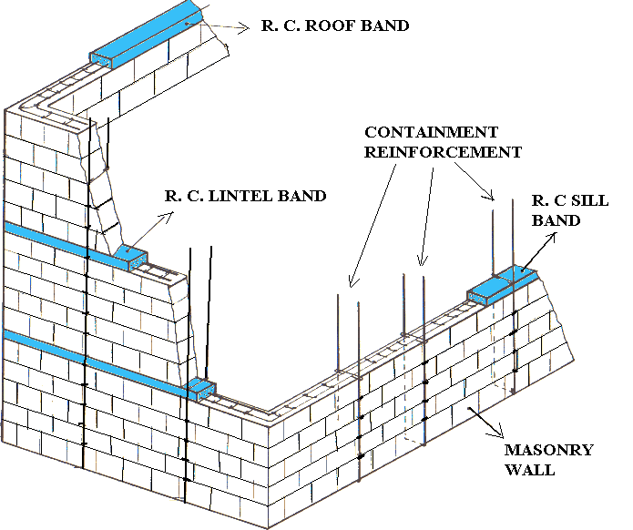

Performance of Masonry Structures During Earthquakes &
Concepts for Earthquake Resistant Masonry
S Raghunath
Professor, Department of Civil Engineering,
(NBA Accredited for 5 years : 2014-2019)
BMS College of Engineering, Bangalore 560019
Email: raghunath.smrc@gmail.com, raghu.civ@bmsce.ac.in
www.bmsce.ac.in

Slide 2
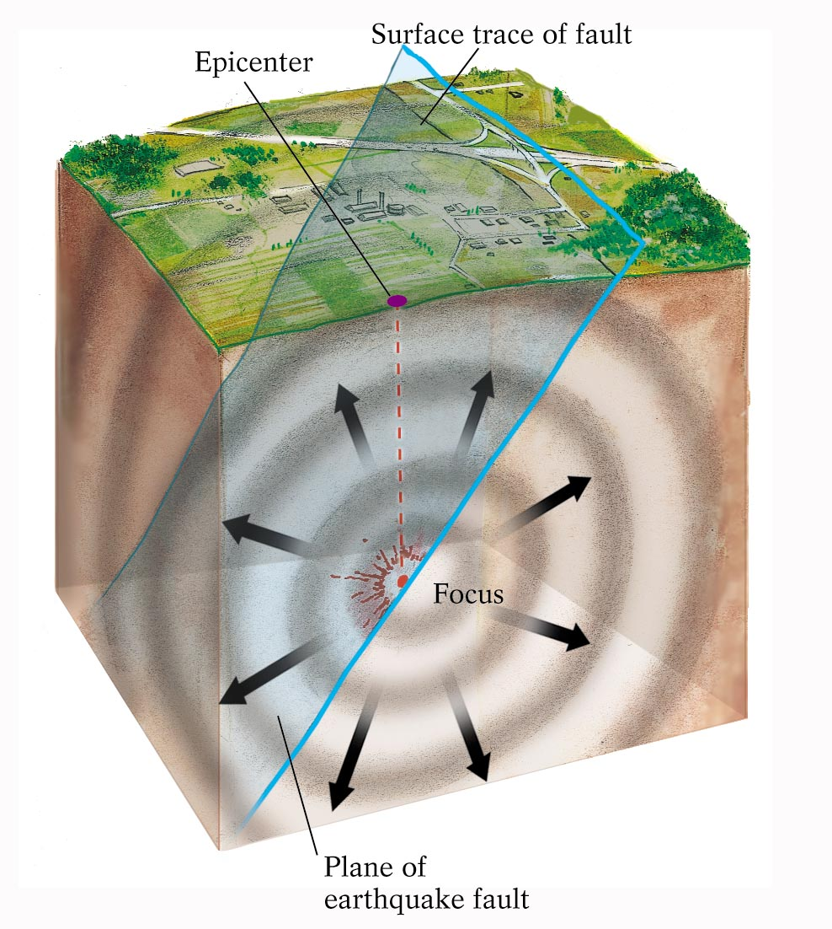

Slide 3
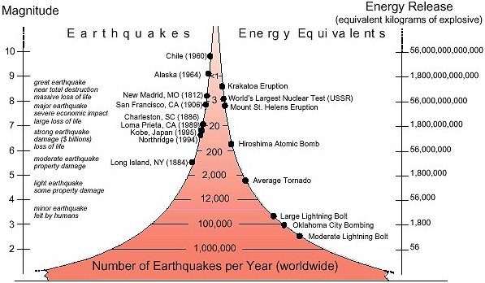
Local Magnitude - Seismic Energy correlation
Gujarat (2001)
This figure was produced in cooperation with the US Geological Survey, and the University of Memphis private foundations

Slide 4
1819 Rann of Kutch earthquake
Allah Bund
The most dramatic effect of this earthquake was the formation of a ridge about 6 m high, extending for 80 km (possibly as much as 150 km) that formed a natural dam across the Puram river.
To distinguish it from the man-made dams that were common in the region, the uplifted area became known as the Allah Bund, or Dam of God.

Slide 5
1897 Assam earthquake
Thought to have triggered 32 km below the surface, it left 390,000 sq. km of masonry buildings in ruins and was felt over 650,000 square kilometres from Burma to New Delhi

Slide 6
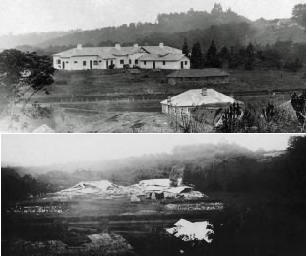

Slide 8
Objectives
  Understand Structural Masonry
  Terminologies in Structural Masonry
  Masonry design concepts
  Behaviour of masonry structures during earthquakes – Performance and Failure modes
  Concepts for earthquake resistant masonry
  Design procedure for earthquake load analysis of masonry buildings

Slide 9
 | Concrete | Masonry
Composition | Fine aggregate, coarse aggregate and binding material | Masonry units and mortar (fine aggregate and binding material)
Distribution of constituents
Behaviour

Slide 10
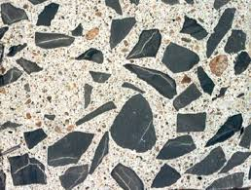
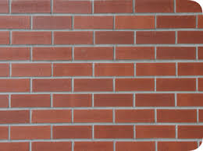
 | Concrete | Masonry
Composition | Fine aggregate, coarse aggregate and binding material | Masonry units and mortar (fine aggregate and binding material)
Distribution of constituents
Behaviour

Slide 11
 | Concrete | Masonry
Composition | Fine aggregate, coarse aggregate and binding material | Masonry units and mortar (fine aggregate and binding material)
Distribution of constituents
Behaviour | Good in compression, weak in tension, Brittle, Crack pattern is irregular Can be considered isotropic | Good in compression, weak in tension, Brittle, Cracks occur generally at unit-mortar interface, Orthotropic

Slide 12
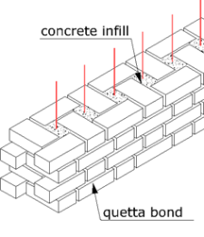
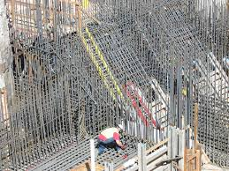
 | Concrete | Masonry
Reinforcement
For a civil engineer

Slide 13


 | Concrete | Masonry
Reinforcement
For a civil engineer

Slide 14
Advantages of Masonry
No formwork
Plays a dual role – functional and structural
Economy
Durable
Aesthetic
Can be made ductile
Can be made light-weight
Disadvantages of Masonry
Structurally very complex
Too many variables!

Slide 15
Structural Walls have 3 functions:
Resist vertical compression
Resist out-of-plane bending from eccentric vertical loads (gravity loads), and/or transverse loads such as wind loads and earthquake loads
Resist in-plane forces (in-plane shear and in-plane bending) attracted by the masonry building as a whole

Slide 16
Masonry is
Weaker than the brick
Weaker than the mortar (?)
Example
Block strength 40.0 N/mm²
Mortar type H1, strength 8.0 N/mm²
Masonry strength is only 3.05 N/mm²

Slide 17
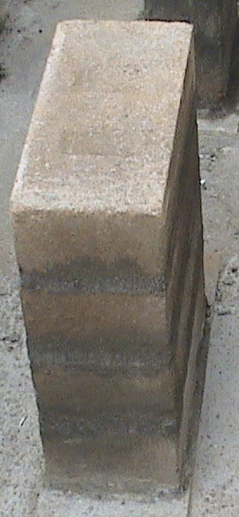
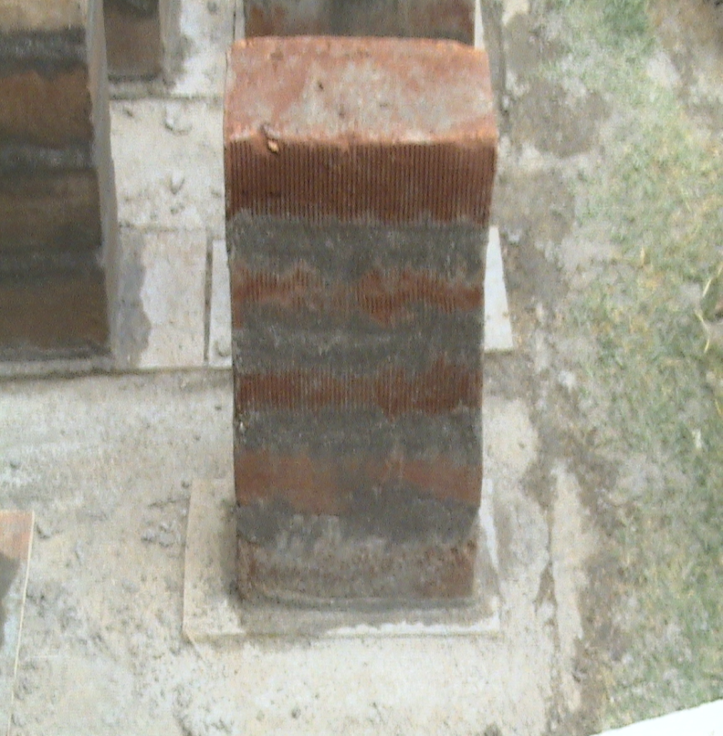
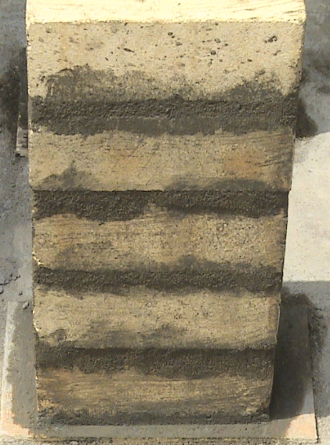
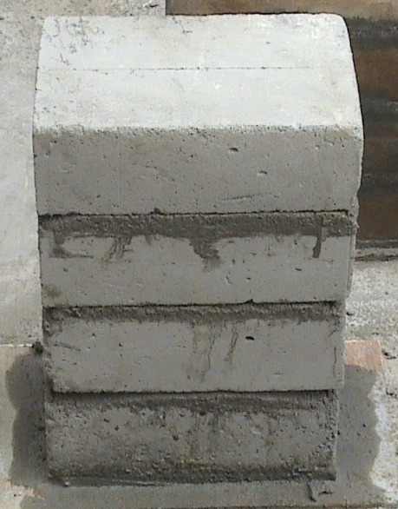
Typical “Masonry Prisms”

Slide 18
Masonry Walls:
Slenderness and Eccentricity
Slender wall, central load
Reduced strength
Stocky wall, central load
100% strength

Slide 19
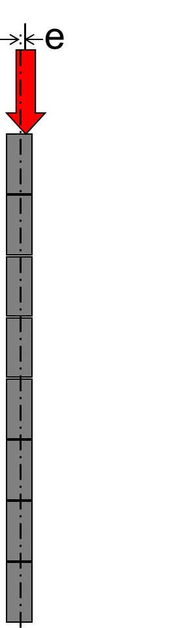
Masonry Walls:
Slenderness and Eccentricity
Slender wall, eccentric load
Much more reduced strength
e
Stocky wall, eccentric load
Reduced strength

Slide 20
Effective height
Slenderness
Ratio
Effective length
Effective thickness
Stress Reduction Factors
Eccentricity of load
Ult. load on wall x Factors (of safety)

Slide 21
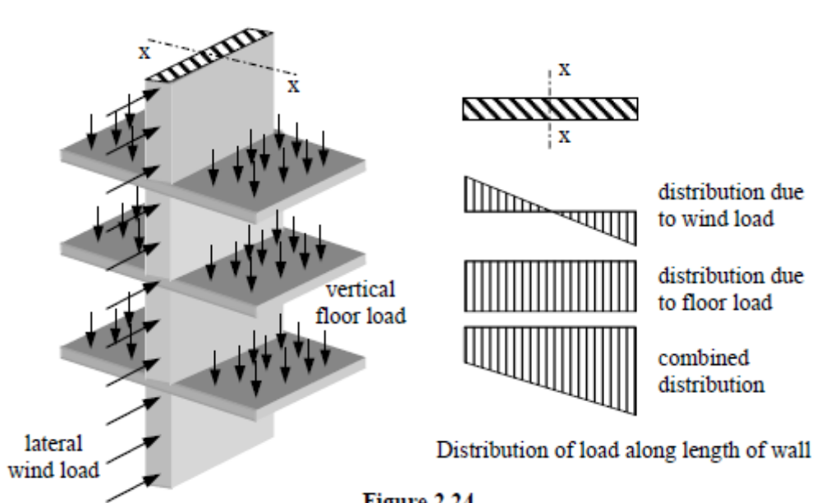

Slide 22
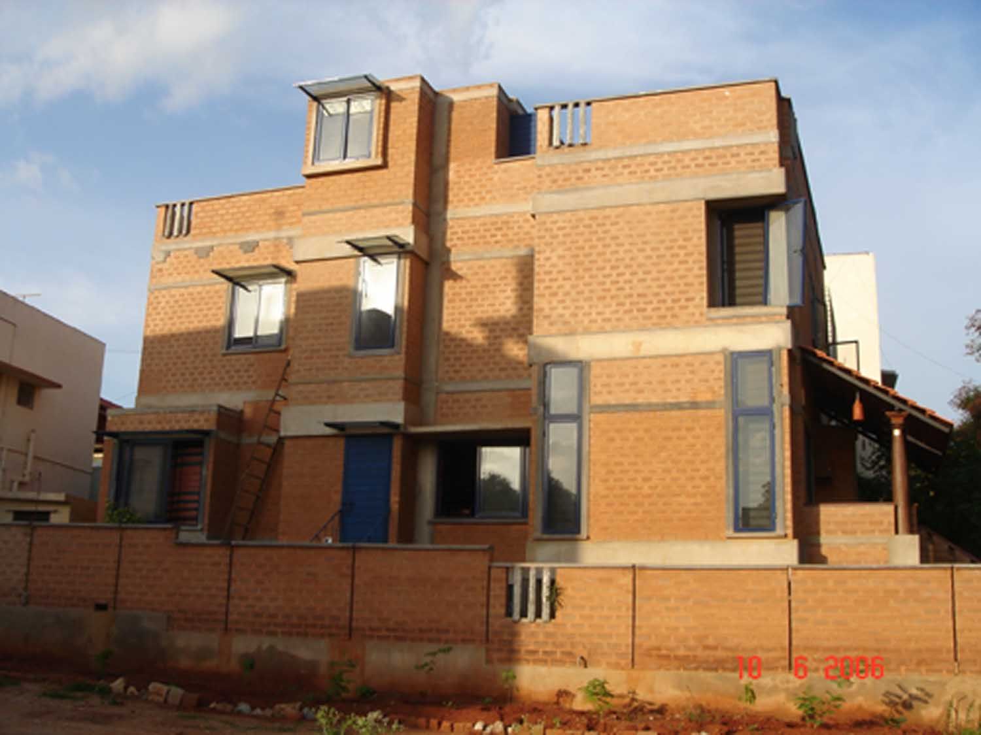
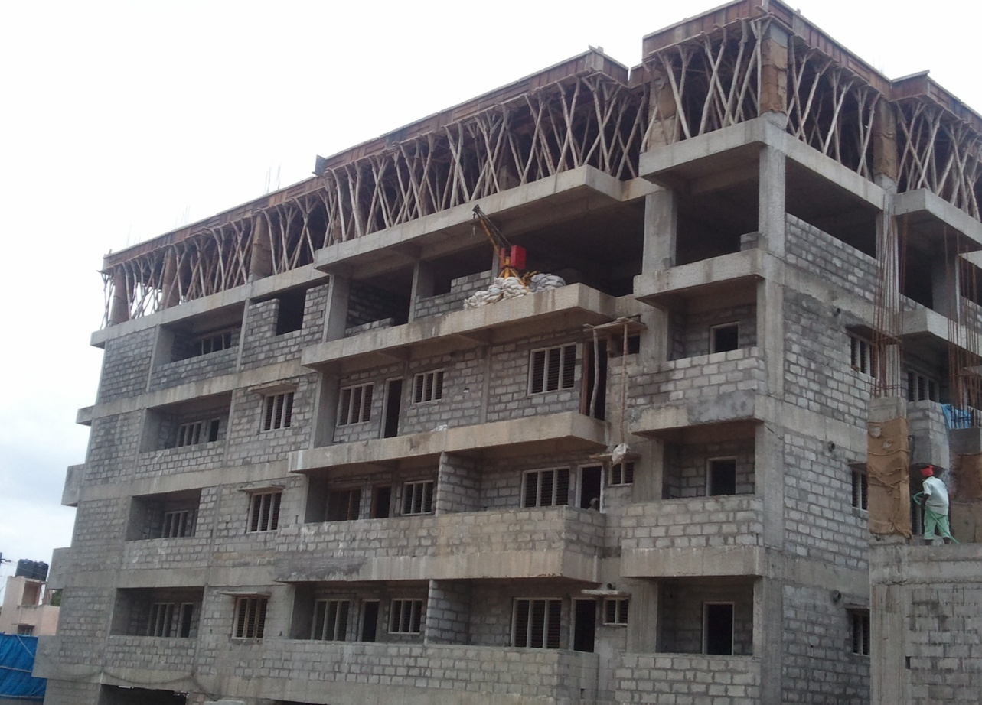

Slide 23
In un-reinforced masonry structures the lateral stability is provided by gravity.
No tension can be allowed to develop at the base of the structure. Hence un-reinforced masonry structures have to be sufficiently massive (large base width) so that the resultant of all forces acting on the structures does not fall outside the middle third of the base.

Slide 24
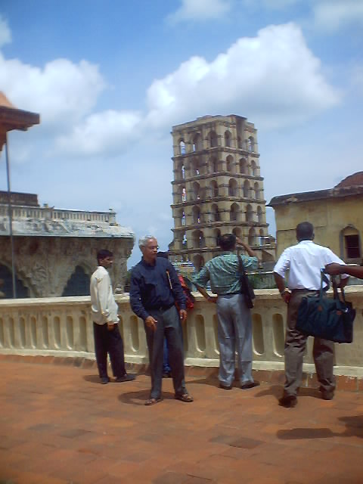
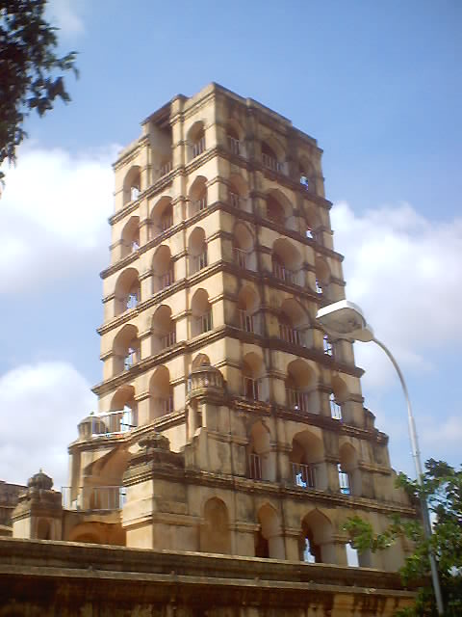
Multi-storeyed Un-reinforced masonry tower, Tanjavur, India

Slide 25
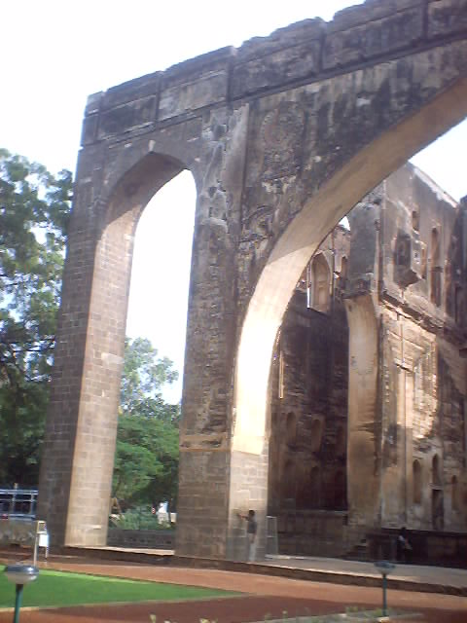
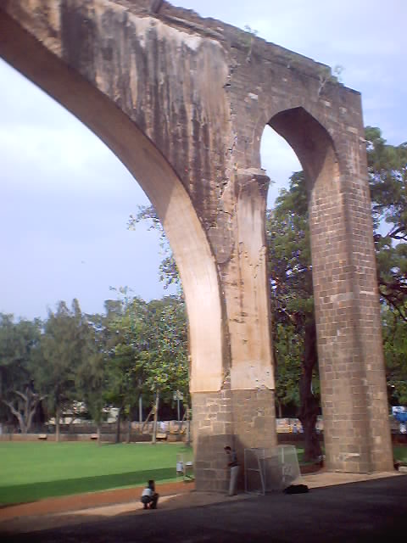
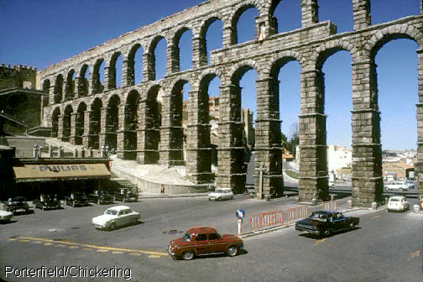
Un-reinforced masonry arches and aqueducts
(Ref: KS Jagadish and BP Sinha)

Slide 26
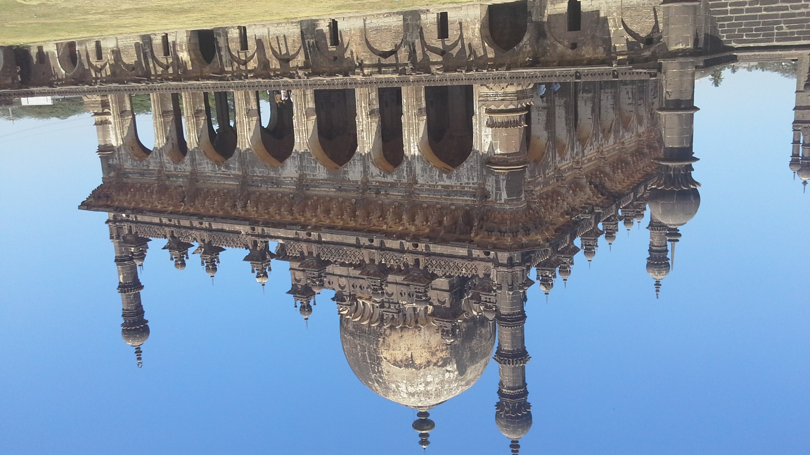

Slide 27



Slide 28
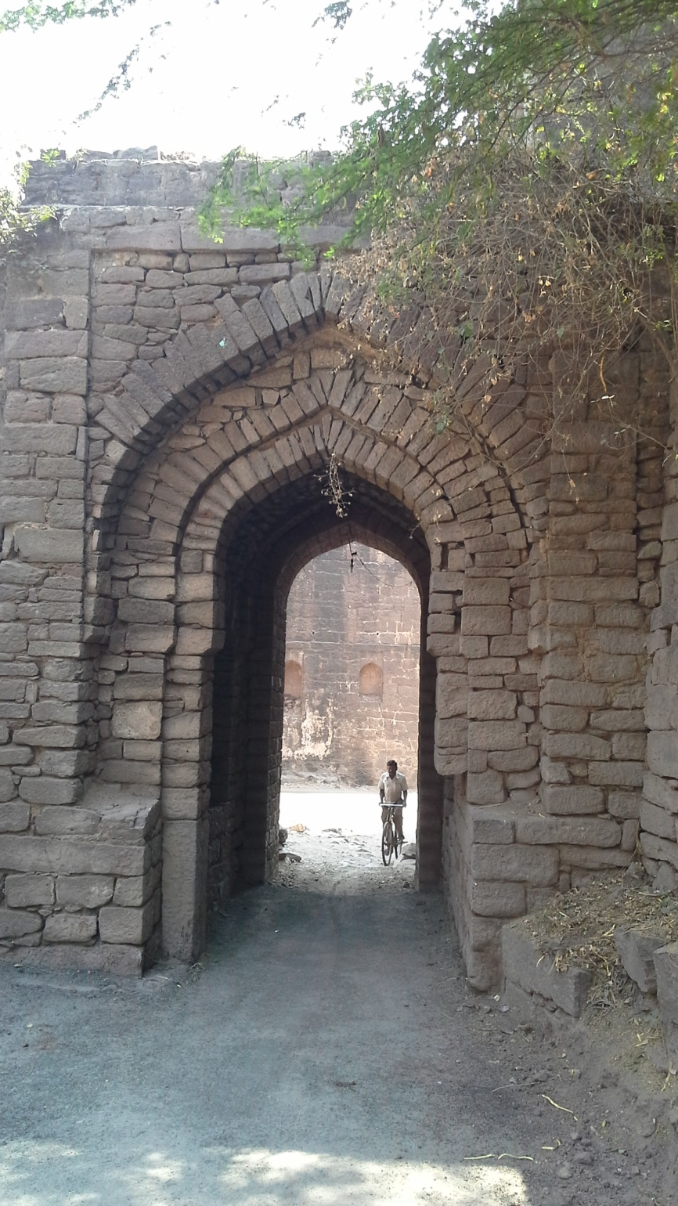
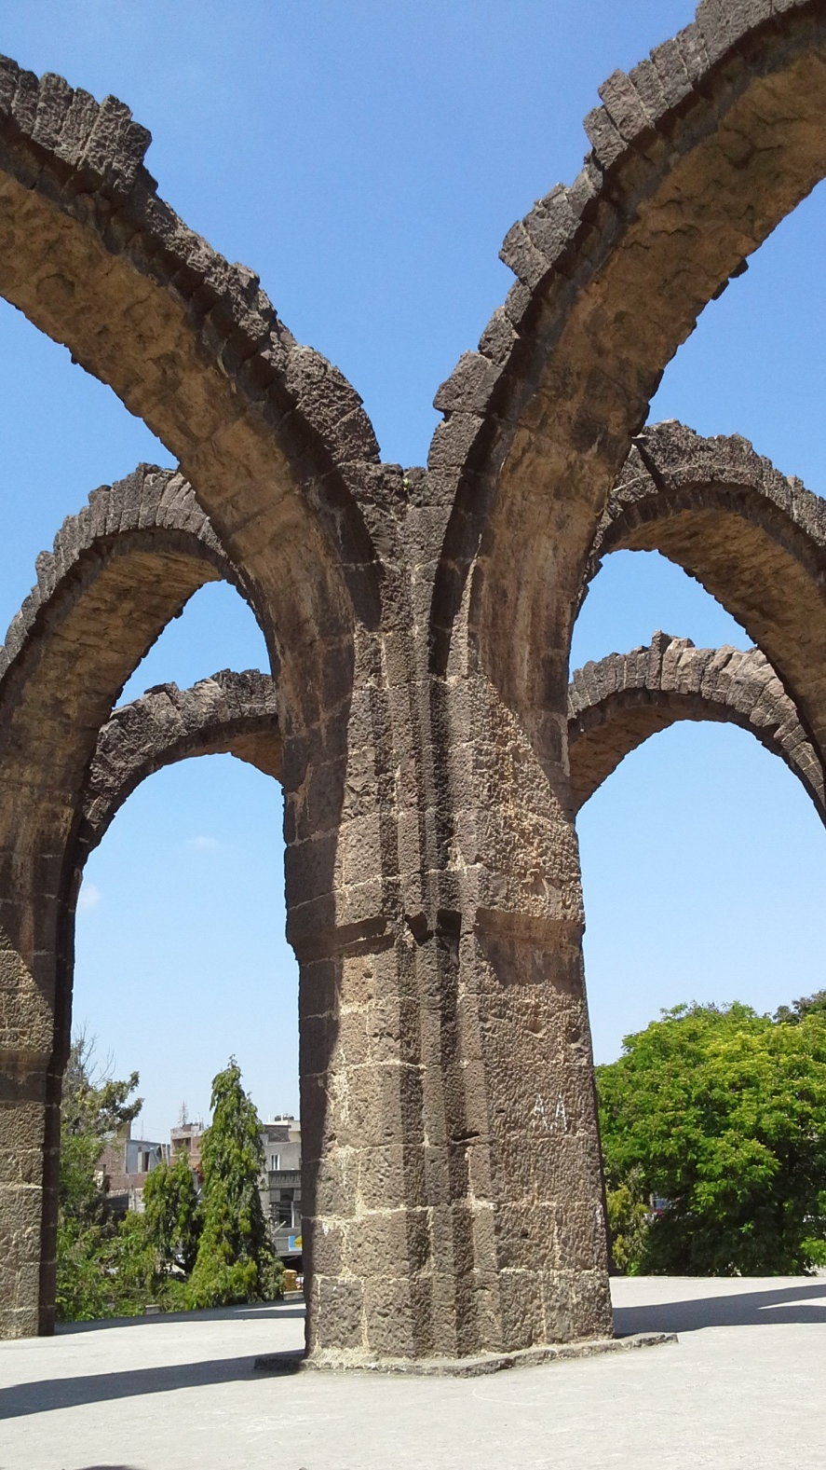

Slide 29
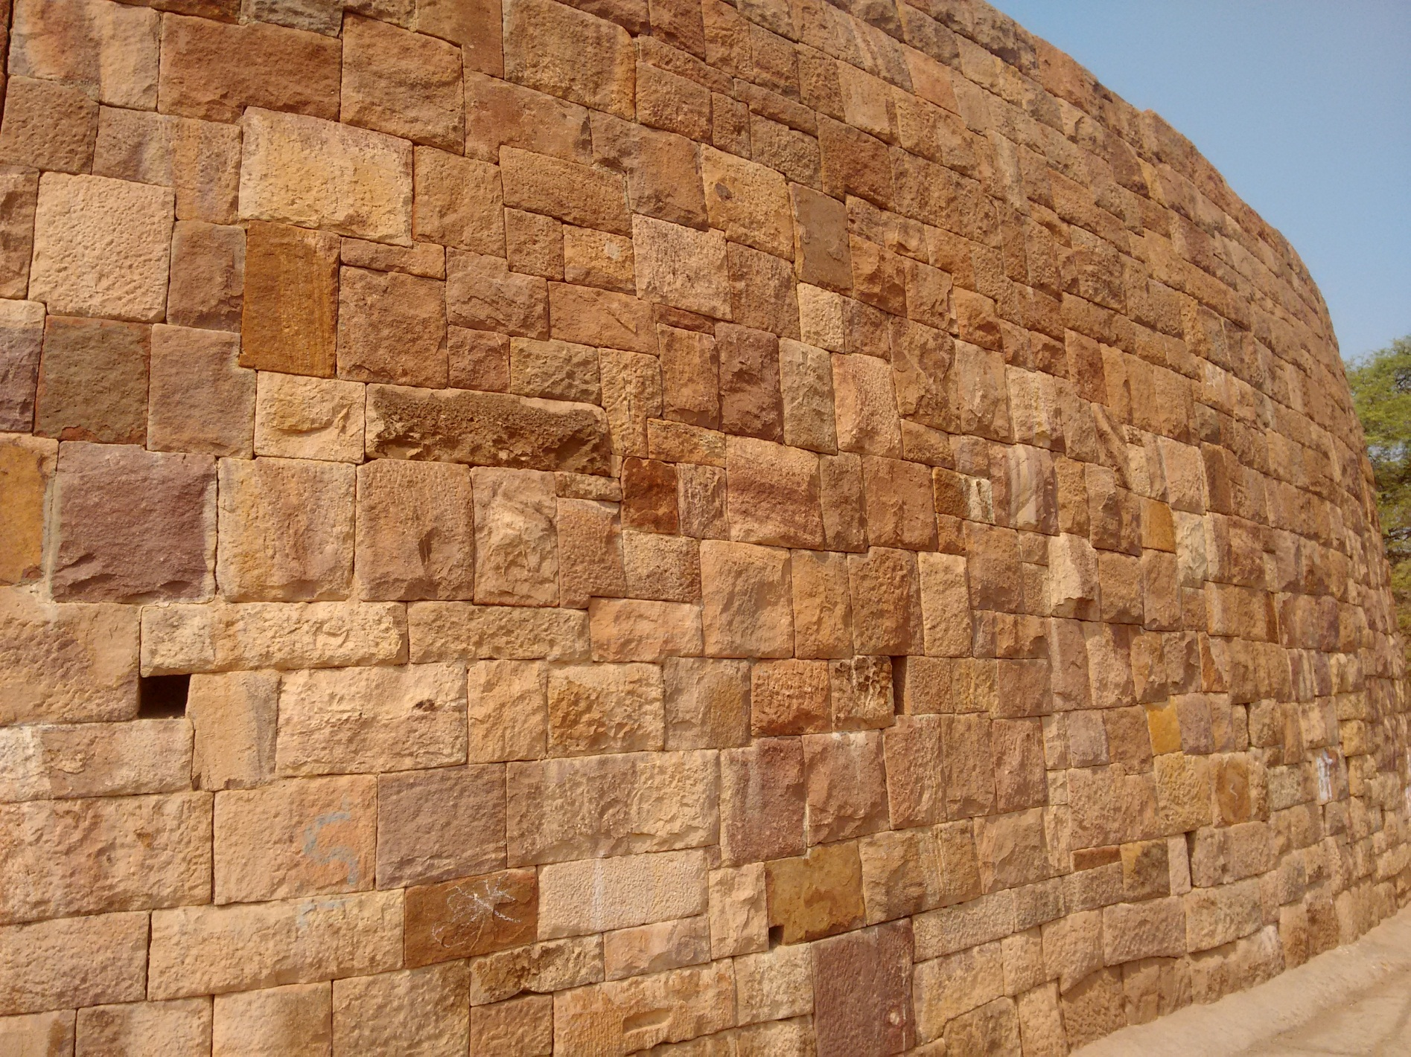

Slide 30
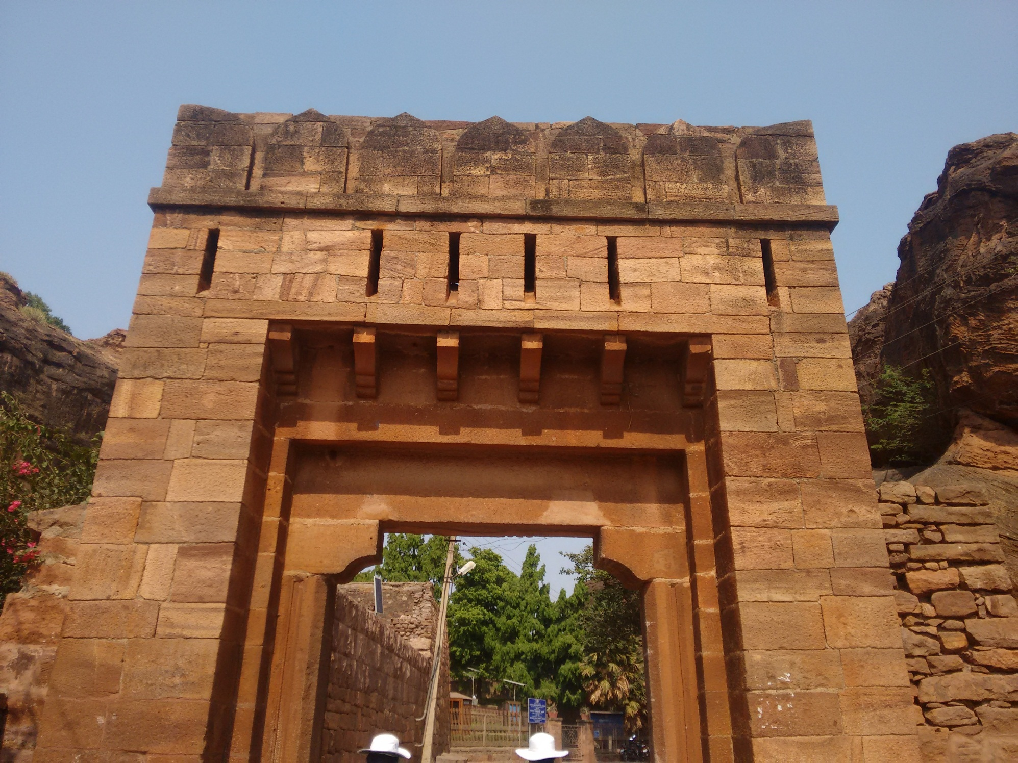

Slide 31
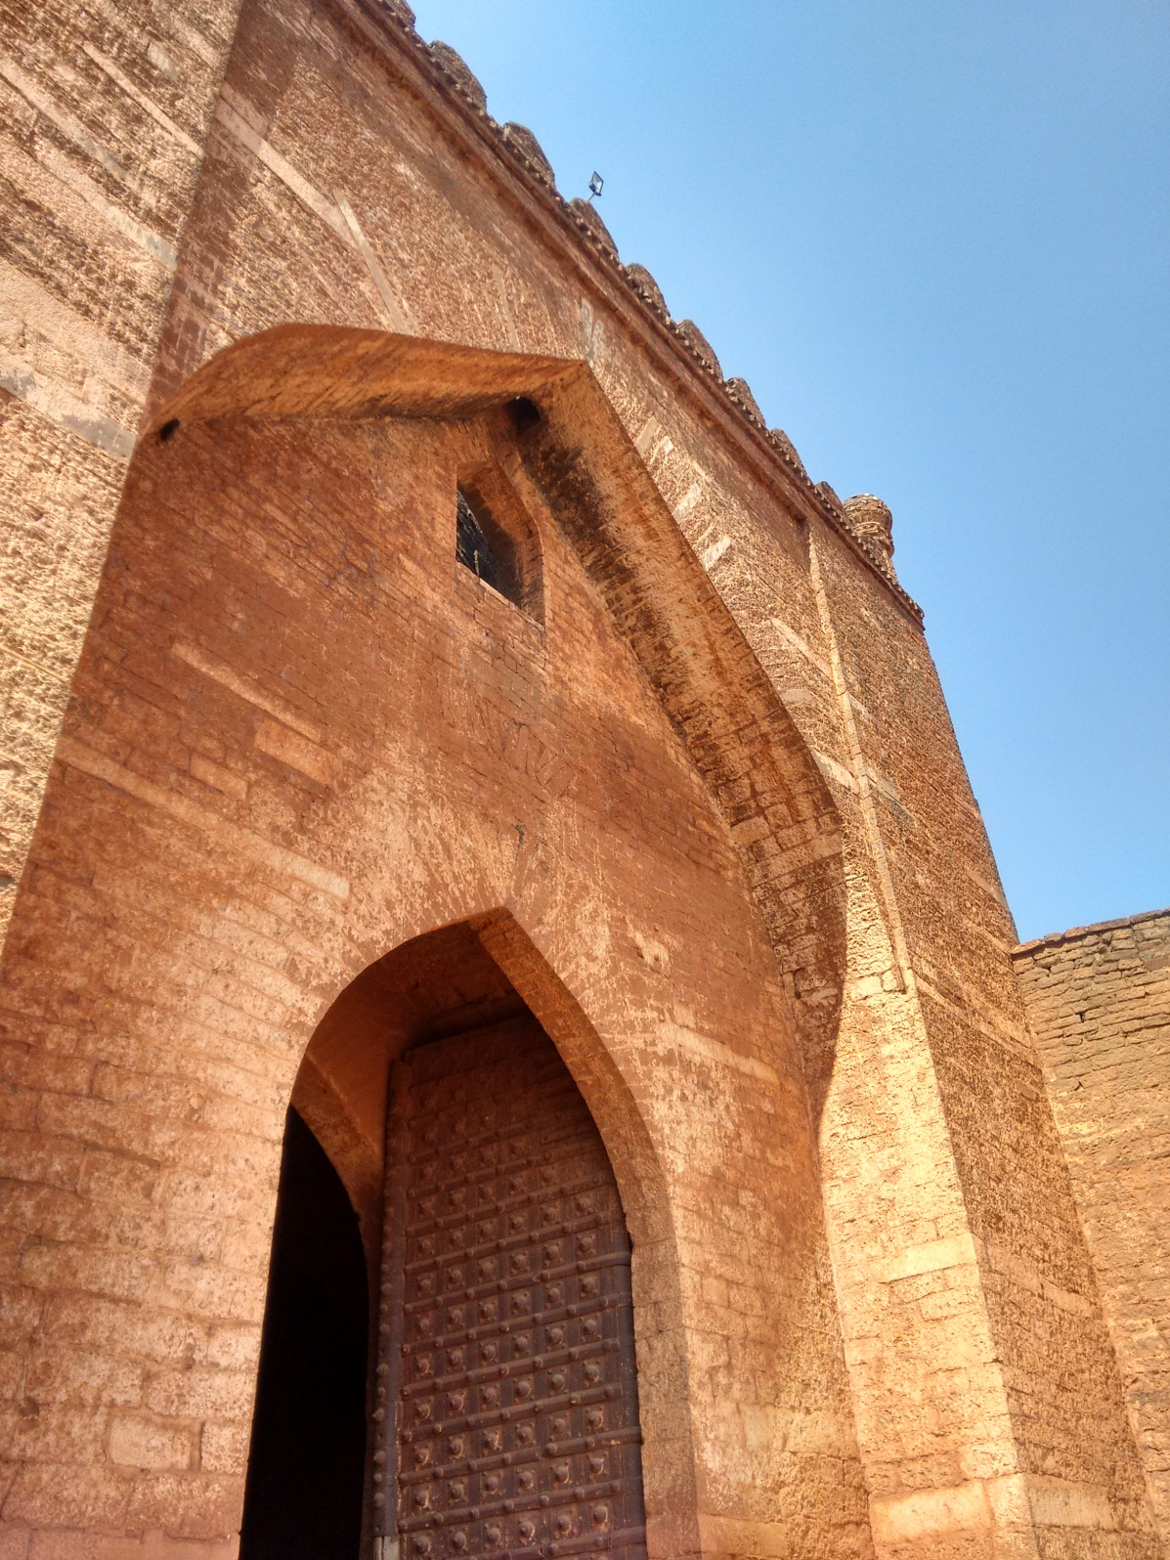

Slide 32
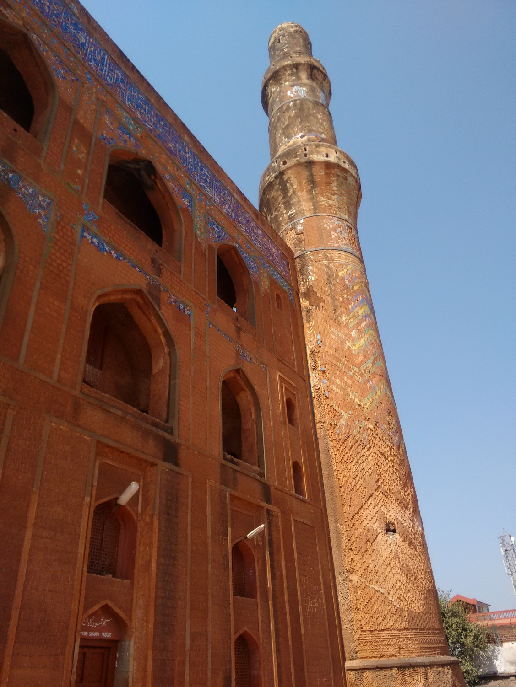
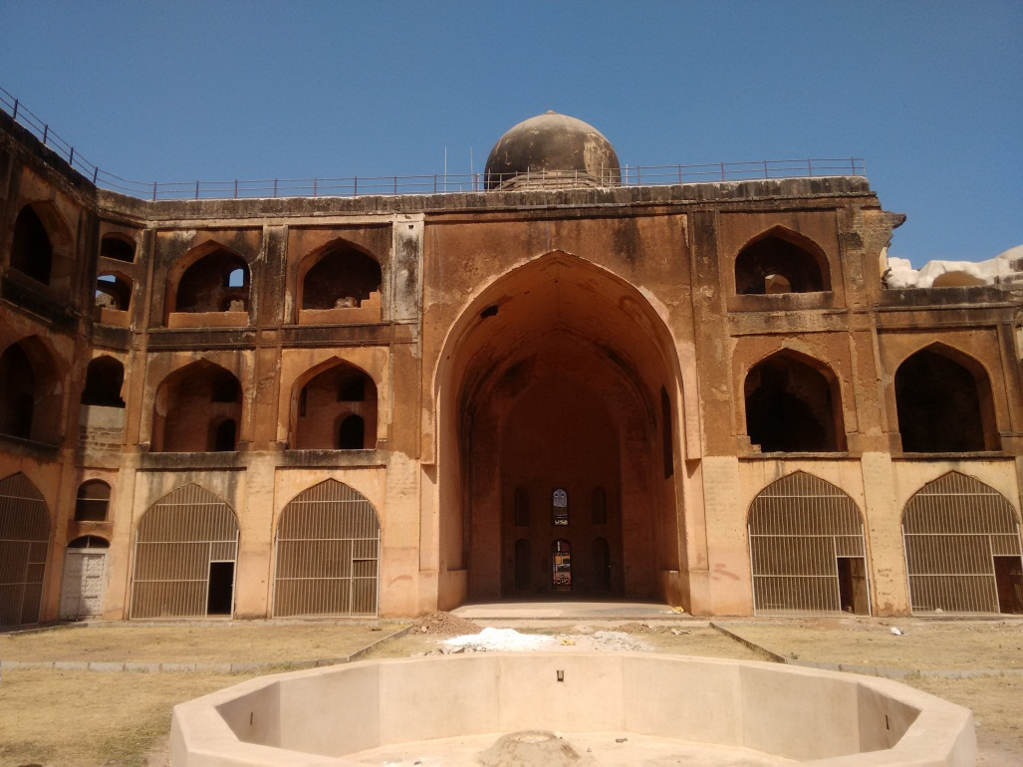

Slide 33
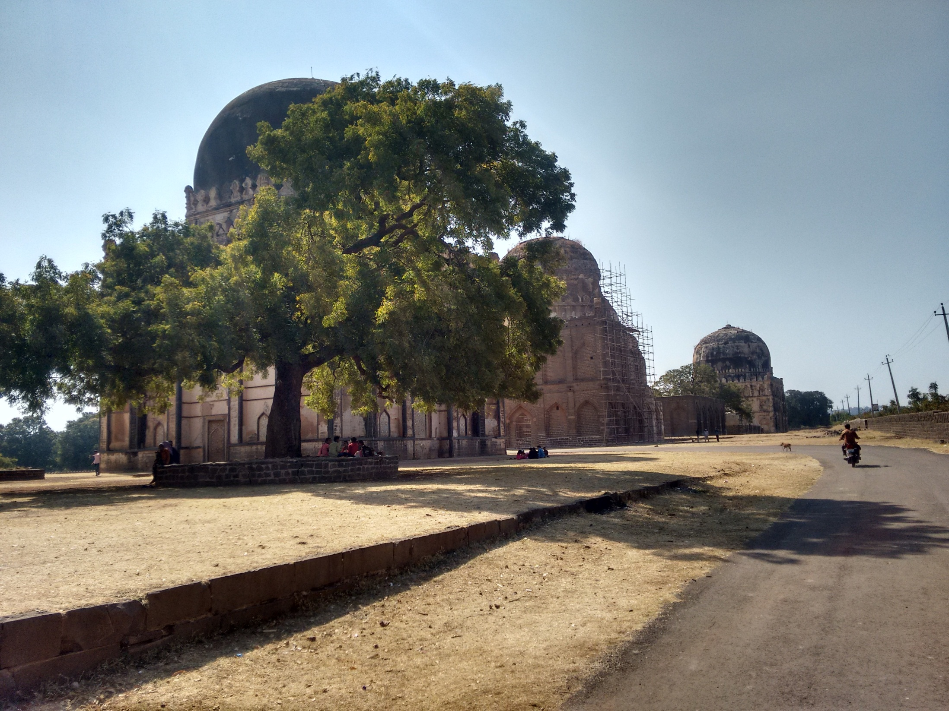

Slide 34
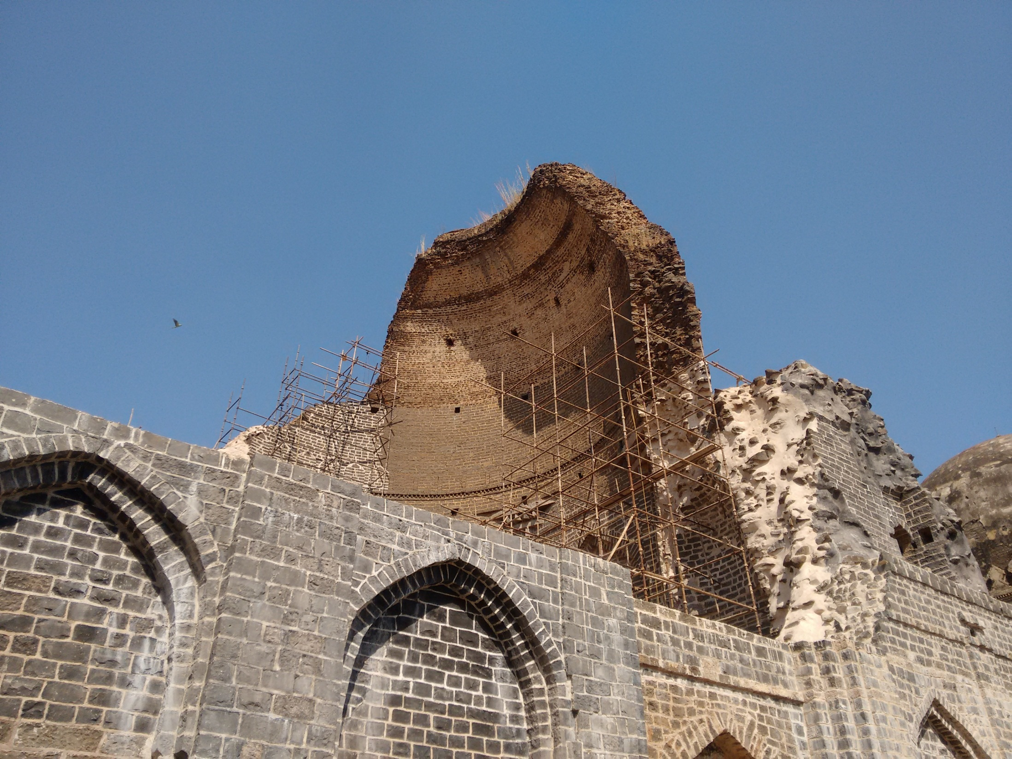

Slide 35
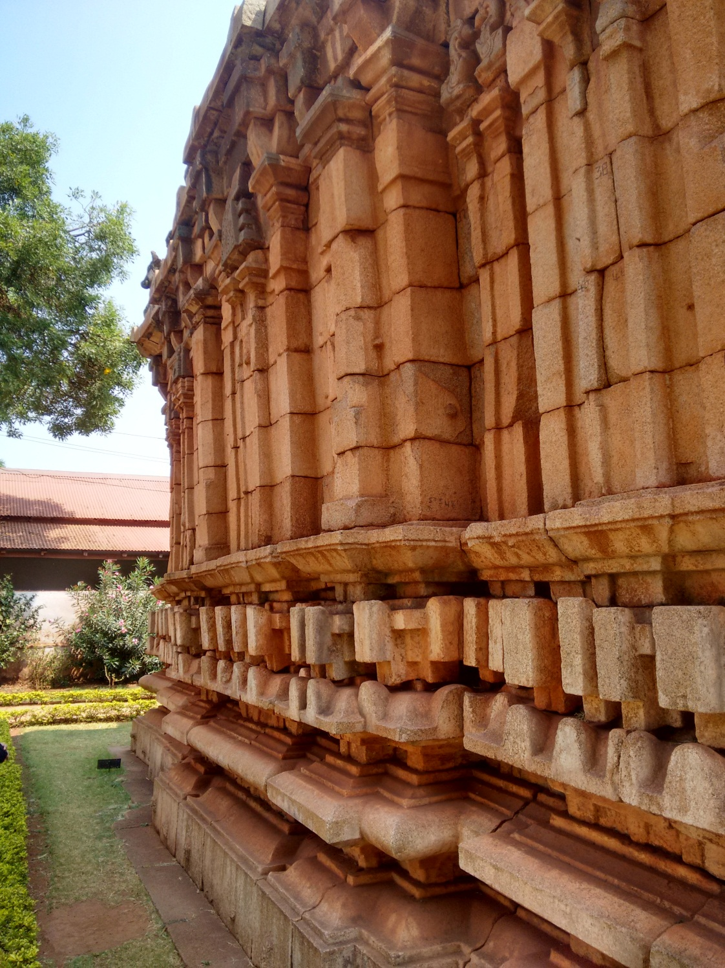

Slide 36
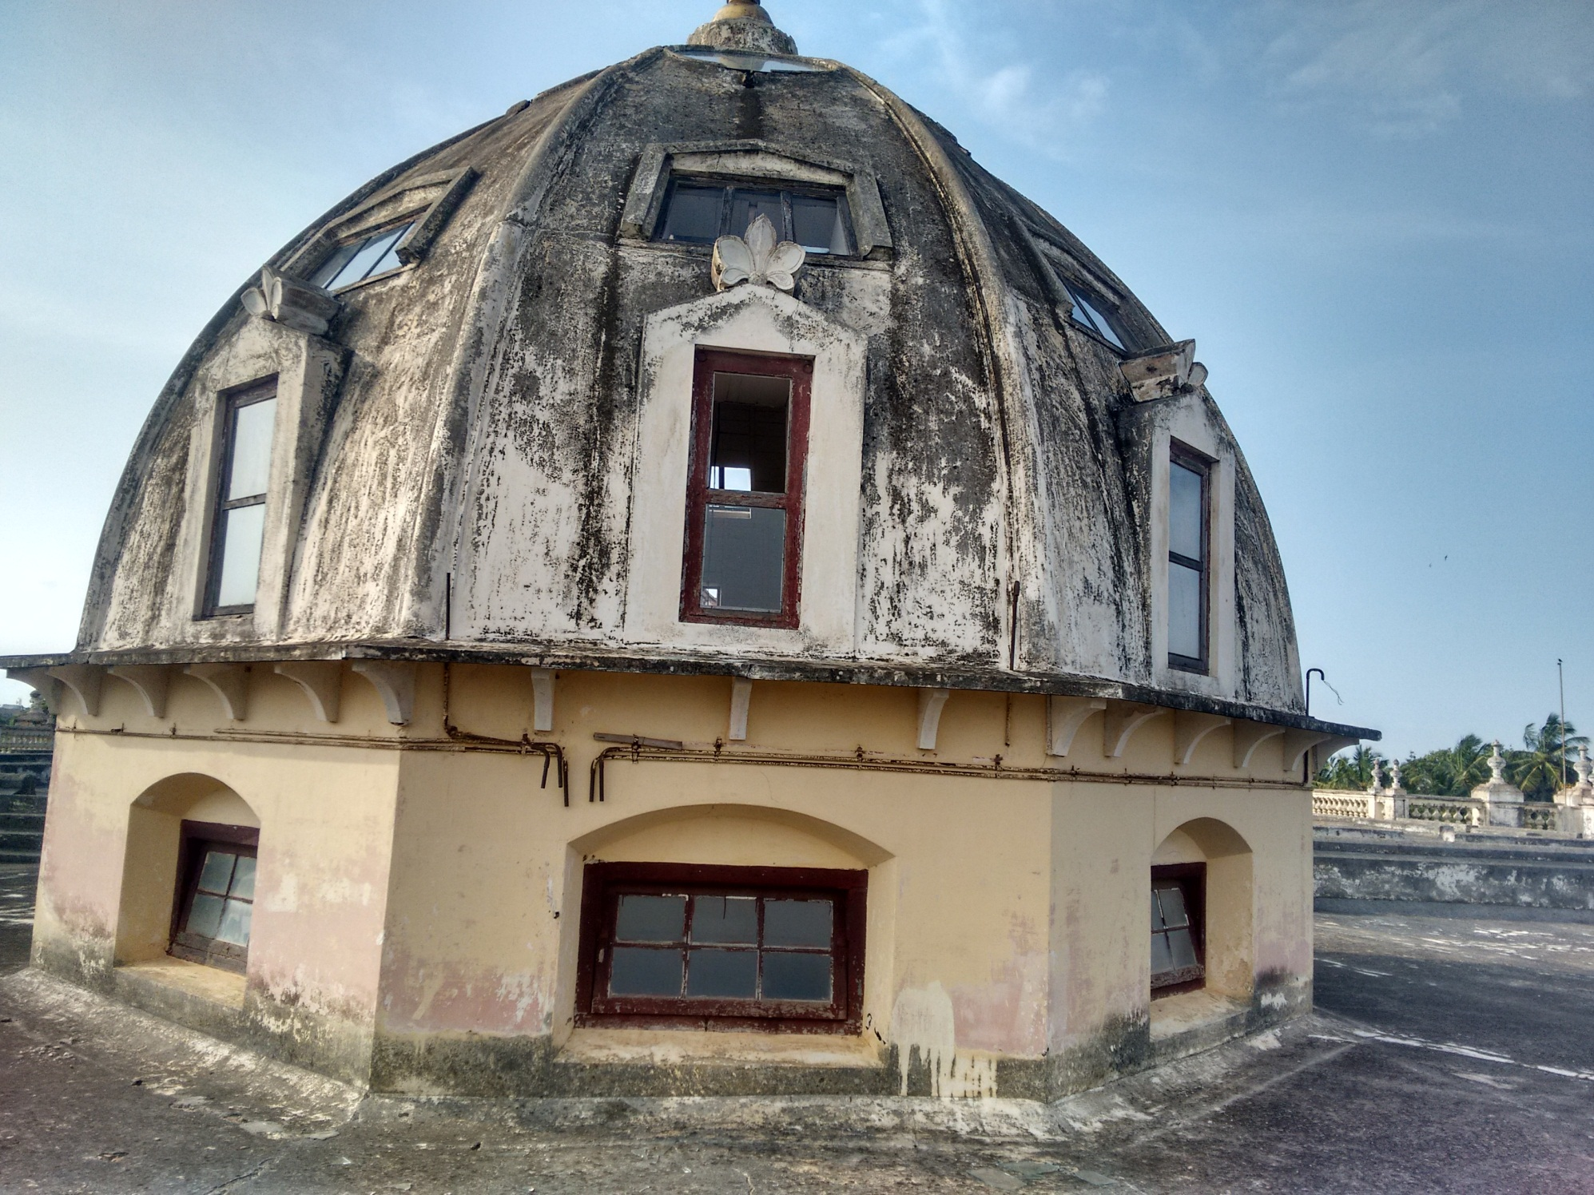

Slide 37


Slide 38
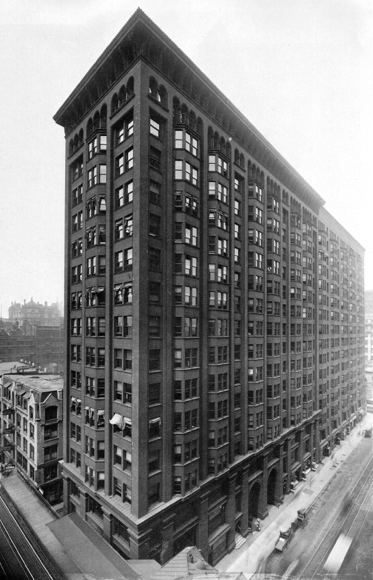
Monadnock Building, Chicago, 1891
1.82m thick wall at basement!
(Ref: BP Sinha)

Slide 39
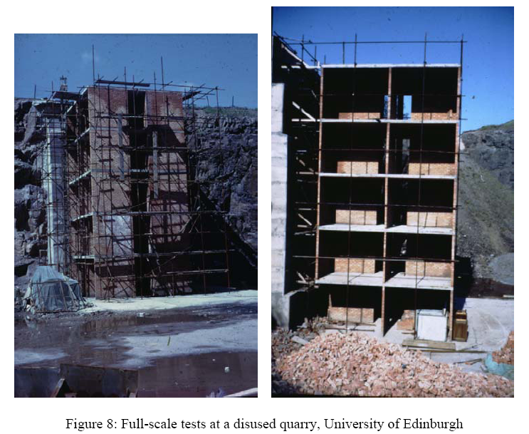
Stability concept (Ref: BP Sinha)

Slide 40
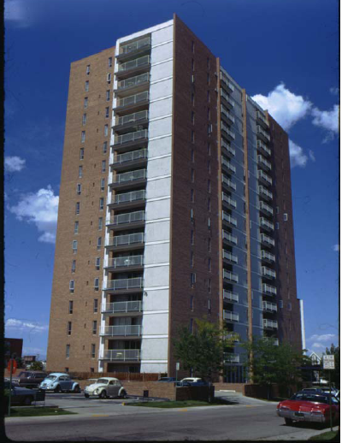
16 storeyed load bearing masonry
(Ref.: BP Sinha)

Slide 41
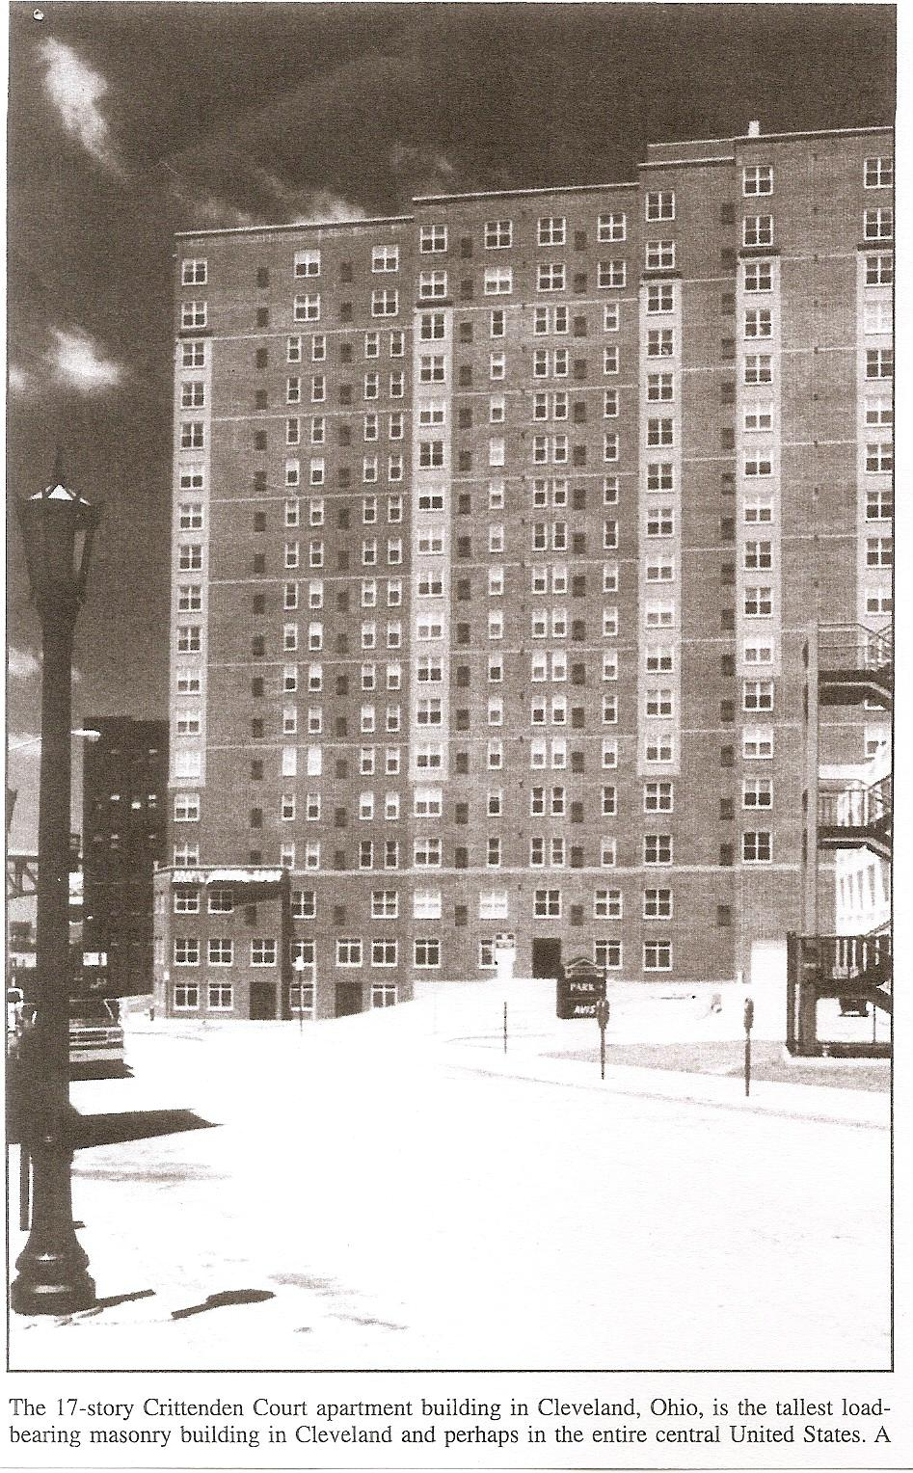
18 storeyed load bearing masonry at Cleveland
(Ref.: BP Sinha)

Slide 42
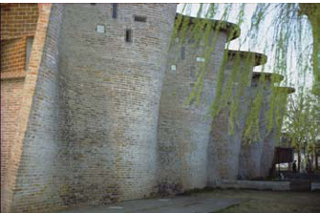
Stability concept, Atlintada Church designed by E. Dieste (Ref: BP Sinha)

Slide 43
Reinforced Masonry
Un-reinforced load bearing masonry should be avoided since it is not entirely insulated from brittle modes of failure. This can be easily rectified by the usage of reinforced masonry.
Lesser unit weight when compared to massive URM
Eliminating the need for RC beams
Elimination of expensive form work which is otherwise required in conventional RC framed construction

Slide 44
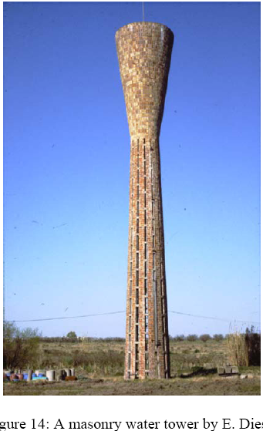
Reinforced masonry

Slide 45
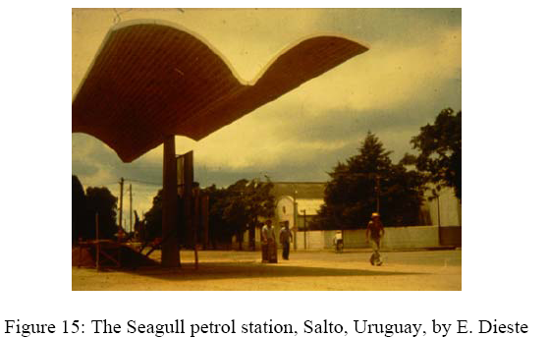
Reinforced/Pre-stressed masonry

Slide 46
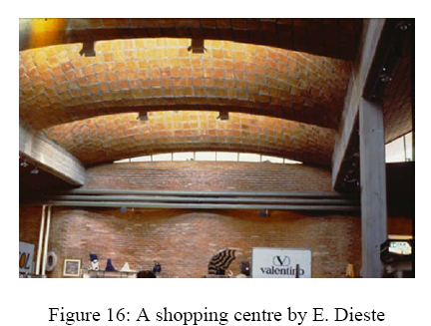
Reinforced/Pre-stressed masonry

Slide 47
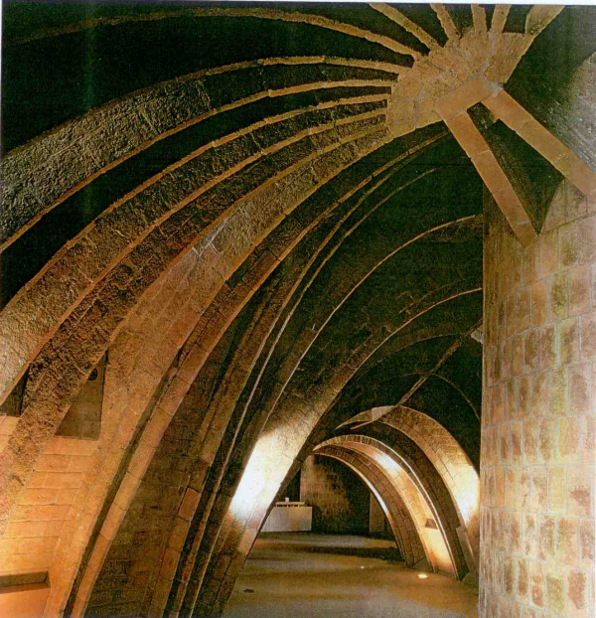
ANTONIO GAUDI – LA PEDRERA

Slide 48
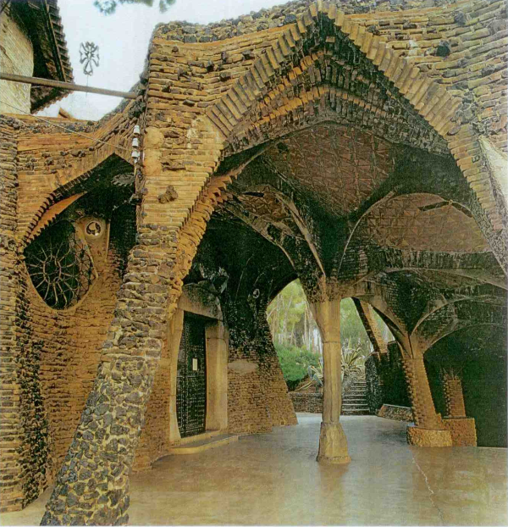
ANTONIO GAUDI – CRYPT OF THE GUELL INDUSTRIAL VILLAGE

Slide 49
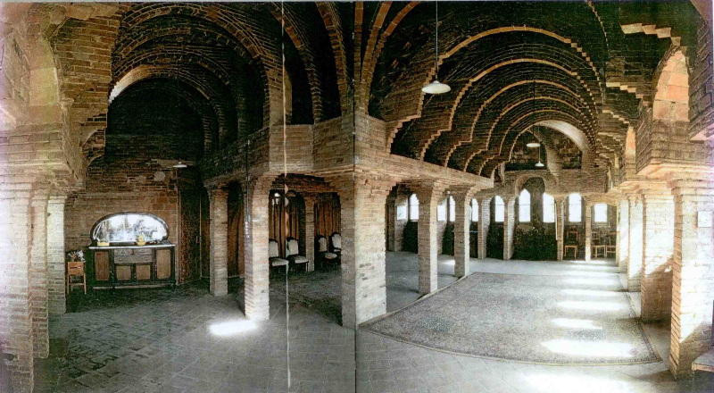
CORBELLED ARCH (ANTONIO GAUDI)

Slide 50
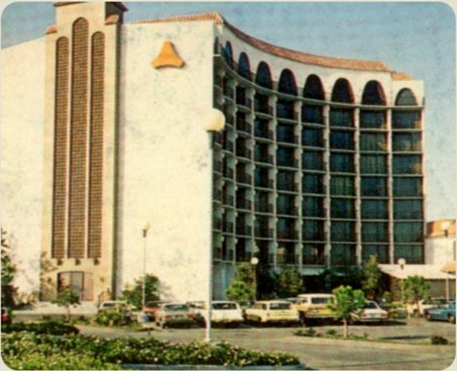
9 STOREYED HOTEL – NASHIK
- LOAD BEARING MASONRY BUILDING.
- HOLLOW CONCRETE BLOCKS.

Slide 51
To be chosen:
Strength of brick or block
Type of mortar
Factors:
Load on wall, kN/m
Eccentricity of load
Effective height of wall
Effective length of wall
Effective thickness of wall

Slide 52
Masonry is
Weaker than the brick
Weaker than the mortar (?)
Example
Block strength 40.0 N/mm²
Mortar type H1, strength 8.0 N/mm²
Masonry strength is only 3.05 N/mm²

Slide 53
Typical “Masonry Prisms”

Slide 54
Masonry Walls:
Slenderness and Eccentricity
Slender wall, central load
Reduced strength
Stocky wall, central load
100% strength

Slide 55
Masonry Walls:
Slenderness and Eccentricity
Slender wall, eccentric load
Much more reduced strength
e
Stocky wall, eccentric load
Reduced strength

Slide 56
Effective height
Slenderness
Ratio
Effective length
Effective thickness
Stress Reduction Factors
Eccentricity of load
Ult. load on wall x Factors (of safety)

Slide 57
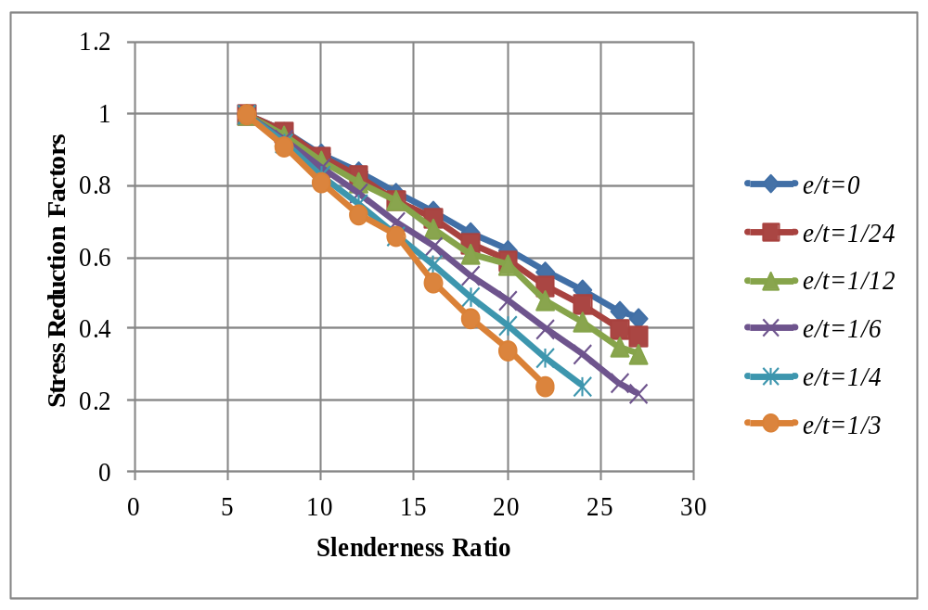
Stress reduction factors as per IS 1905

Slide 58
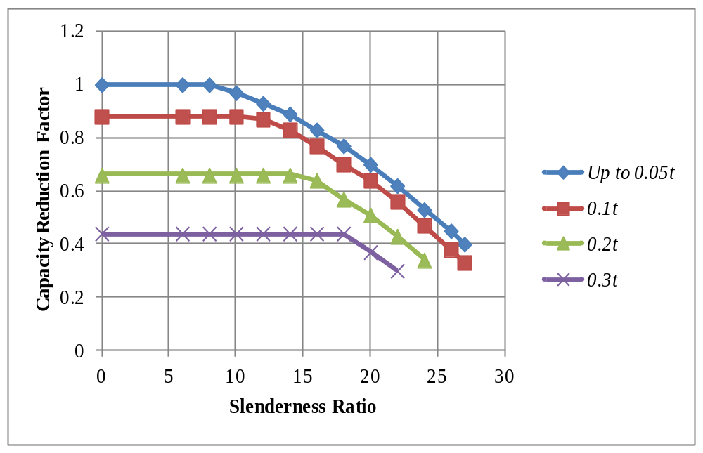
Capacity reduction factors as per BS 5628

Slide 59
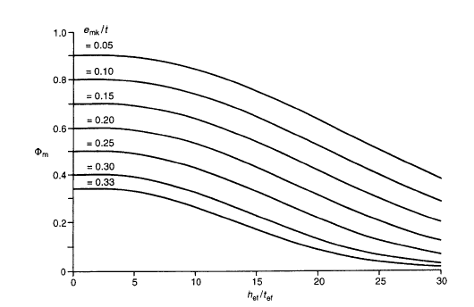
Capacity reduction factors as per EURO Code

Slide 61
Structural Walls have 3 functions:
Resist vertical compression
Resist out-of-plane bending from eccentric vertical loads (gravity loads), and/or transverse loads such as wind loads and earthquake loads
Resist in-plane forces (in-plane shear and in-plane bending) attracted by the masonry building as a whole

Slide 62
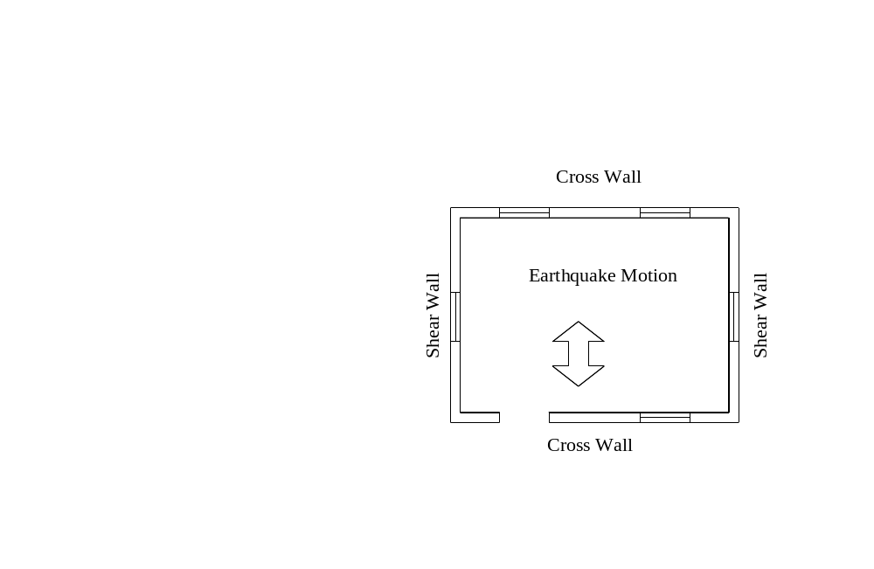

Slide 63


Slide 64
Summary:
Masonry is the most simplest load bearing system. The walls are ‘constructed’ to remain ‘stable’. Having ensured ‘stability’, the load carrying capacity is then checked.
As ‘slenderness’ and ‘eccentricity’ of applied vertical load increases, the load carrying capacity reduced significantly.
In case of un-reinforced masonry, it is to be ensured that ‘tensile stresses’ do not develop in any of the walls because masonry is very brittle, particularly in tension.

Slide 65


Earthquake Protection
(Coburn and Spence, 2002)

Slide 66

Grade 1: Negligible to slight damage (no structural damage)

Slide 67

Grade 2: Moderate damage (slight structural damage, moderate non-structural damage)Large and extensive cracks in many walls; parts of chimneys fall down.

Slide 68

Grade 3: Substantial to heavy damage (moderate structural damage, heavy non-structural damage);large and extensive cracks in most walls; pan tiles or slates slip off; chimneys are broken at roof line; failure of individual non-structural elements.

Slide 69
Grade 3: Substantial to heavy damage (moderate structural damage, heavy non-structural damage);large and extensive cracks in most walls; pan tiles or slates slip off; chimneys are broken at roof line; failure of individual non-structural elements.

Slide 70

Grade 4: Very heavy damage(heavy structural damage, very heavy non-structural damage);serious failure of walls; partial structural collapse.

Slide 71
Grade 5: Destruction (very heavy structural damage) ; Total or near total collapse.

Slide 72


Slide 74


Slide 75


Slide 76


Slide 78


Slide 79


Slide 80


September 30, 1993 Latur earthquake….

Slide 81


Slide 82
Out-of-plane collapse of sandstone in lime mortar masonry wall (MORBI)

Slide 83
House with lintel band and columns (SAMAKHYALI)

Slide 84

Combination of in-plane and out-of-plane failure (Samakhyali)

Slide 85

Separation of corner column from the neighbouring masonry (SAMAKHYALI)

Slide 86
Stone masonry building in CM – minor damage(BHUJ)

Slide 87

Out-of-plane failure of wall leading to collapse of lintel band (BHUJ)

Slide 88
Corner failure in presence of corner reinforcement (BHUJ)

Slide 89

Collapse of walls between openings (KHAVDA)

Slide 90
Rigid box like behaviour above lintel band (BHACHAU)

Slide 91

Shear cracks in stair-case room of a school bldg. (Morbi)

Slide 92

Damage due to a combination of in-plane and
out-of-plane vibration (Samakhyali)

Slide 93

Out-of-plane collapse of stair case room of a school building (Morbi)

Slide 94

Wall flexure – RC roof on stone-in-CM (Lodhrani)

Slide 95

Vulnerability of parapets and other projections (Morbi)

Slide 96

Vulnerability of light-roofed masonry house (Khavda)

Slide 97


Slide 98

Out-of-plane failure and buckling of wythes

Slide 99

Vulnerability of heavy-roofed masonry house

Slide 100

Haiti earthquake (2010)

Slide 101

Vulnerability of masonry, Haiti earthquake (2010)

Slide 102
Summary of types of masonry building damages/failures
Out-of-plane collapse and or shear failure
In-plane shear and or flexure failure
Separation of wall junctions
Failure of masonry pier in between openings
Local failures
Buckling of wythes
Separation of roof from walls

Slide 103
EARTHQUAKE RESISTANT MASONRY

Slide 104


Slide 105


Slide 106

TURKEY

Slide 107

TURKEY

Slide 108

UTTRAKHAND

Slide 109

UTTRAKHAND

Slide 110

UTTRAKHAND

Slide 111

HIMACHAL PRADESH

Slide 112

HIMACHAL PRADESH

Slide 113


Slide 114


Slide 115


Slide 116


Slide 117
Response of structures during earthquake depends on
Natural frequencies of the structure (which is dependent on Mass (M) and Stiffness (K)
Frequency content of earthquake
Amplitude of earthquake
Duration of earthquake
Ductility
Damping characteristics (energy dissipation capacity)
Structural integrity

Slide 118



EIGEN values
Natural frequencies
EIGEN vectors
Mode shapes

Slide 119

period range of masonry buildings

Slide 120
QUASI-STATIC
RESONANT
INERTIAL

Slide 121
building without roof,
without opening (B*)
(b) building without roof,
with opening (B*O)
(c) building with roof,
without opening (B*R)
(d) building with roof,
with opening (B*OR)
Fig. – 4.5: Building configuration chosen for parametric study

Slide 122
Cross wall
(a)
Shear wall
(b)
Figure 1: Buildings without roof (a) without bands (b) with RC lintel and roof bands
Figure 2: Building with RC roof and lintel band

Slide 123

Fundamental mode shape of building without roof, with openings

Slide 124

Fundamental mode shape of building with roof and openings

Slide 125
σ_{x}
σ_{y}
3.0m
mid-height
Vertical edge
mid-length
Vertical edge
Base
4m, 6m and 9m
Parameters of wall analysis

Slide 126

S S C F boundary condition for the 4 edges of the wall

Slide 127

S S C S boundary condition for the 4 edges of the wall

Slide 128

STRESSES IN MASONRY WALLS DURING EARTHQUAKE GROUND MOTIONS

Slide 129

STRESSES IN MASONRY WALLS DURING EARTHQUAKE GROUND MOTIONS

Slide 130

σ (parallel-to-bed-joints) Strength: < 0.36 MPa

Slide 131

σ (normal-to-bed-joints) Strength: < 0.10 MPa

Slide 132


Regions of maximum flexural stress for buildings without roof (a) σ_{x} (b) σ_{y}

Slide 133


Regions of maximum flexural stress for buildings with roof (a) σ_{x} (b) σ_{y}

Slide 134

Regions of maximum shear stress in shear-walls (τ)

Slide 135

Out of plane flexural collapse

Slide 136

Typical X-type crack

Slide 137
DESIGN PHILOSOPHY
TYPE OF EQ. | CRITERION
MILD | Frequent occurrence NO STRUCTURAL DAMAGES ADMISSIBLE, NON-STRUCTURAL DAMAGES ALLOWED BUT REPAIRABLE
MODERATE | May occur once during the life-time of a structure ALLOW MINOR BUT REPAIRABLE STRUCTURAL DAMAGES
MAJOR | Very rare possibility MAJOR STRUCTURAL DAMAGE ALLOWED, BUT STRUCTURE SHOULD NOT COLLAPSE

Slide 138
Design Principles
Achieve strength and ductile behaviour
Maintain structural integrity
In relatively simple and cost effective manner!

Slide 139
Different ways of reinforcing masonry
Horizontal reinforcement
Vertical reinforcement
Core reinforcement
Containment reinforcement (Surface reinforcement)

Slide 140

IS 4326 – 1993 (re-affirmed 1998), “Earthquake resistant design of buildings – codes of practice”, BIS, New Delhi

Slide 141

IS 4326 – 1993 (re-affirmed 1998), “Earthquake resistant design of buildings – codes of practice”, BIS, New Delhi

Slide 144


Slide 145


Slide 146
EARTHQUAKE RESISTANT MASONRY CONCEPTS
Traditional / Innovative practices
Turkey – Horizontal timber scantlings on either face – 3 levels per floor
Quetta, Kutch – Horizontal and vertical railings with brick in-fill
Horizontal expanded metal every fourth course
Uttarkashi – Horizontal timber bands at different levels

Slide 147
Ref: Tomazevic
Horizontal RC bond beams at 1.0 or 2.0 m spacing
Masonry confined by RC framing, walls keyed to frame
Vertical reinforcement in grouted hollow block masonry
Horizontal steel ties below floor level
Reinforced cement coating (M P Jaisingh)
Ref: Gavrilovic & Ginell
Horizontal RC bond beams, vertical nylon straps on both faces

Slide 148



Slide 149
IS 4326 – 1993 (re-affirmed 1998), “Earthquake resistant design of buildings – codes of practice”, BIS, New Delhi

Slide 150


Slide 151
Vertical reinforcement
Very difficult to provide, especially for masonry with solid blocks
Needs to be grouted by rich mortar/concrete
Provides good shear resistance
Closely spaced vertical reinforcement with grouting may increase the stiffness

Slide 152



Slide 153


Slide 154


Slide 156

IS 4326 – 1993 (re-affirmed 1998), “Earthquake resistant design of buildings – codes of practice”, BIS, New Delhi

Slide 157


Slide 158



Slide 159


Slide 162



(a) Un-reinforced (b) core-reinforced (c)Containment reinforcement

Slide 163
Reinforcement on both faces to be held by ties going through the wall in alternate courses or once in 3 courses
Following materials are possible
    GI wire – 3.0 to 4.0 mm
    Corrosion resistant steel ~ 6.0mm
    Stainless steel – 3.0 to 4.0 mm
    Bamboo
    Timber
Function is to prevent growth of flexural cracks
Experiments show good flexural ductility

Slide 164

1st crack

Slide 165



Slide 166




Slide 167


Slide 169



Slide 170

δs
h
b
(a) In-plane pure shear

Slide 171


δs
δ_{b}bb
F
F
h
h
b
b
(b) In-plane shear + bending (fixed-fixed)

Slide 172


δ_{bc}
δs
F
F
h
h
b
b
(c) In-plane shear + bending (cantilever)

Slide 173


Torsion stiffness of shear wall
Torsion stiffness of cross wall

Slide 174


Slide 175


Slide 176



Slide 177


Slide 178


Slide 179


Slide 180


Slide 181


Slide 182


Slide 183


Slide 184


Slide 185

Shear force distribution along the height (storey shear)

Slide 186

Bending moment distribution along the height

Slide 187


Slide 188


Slide 190
Calculation of Geometric Properties:
Pier Areas (cross sectional)
Area of Pier 1 = (800×190+1000×190) = 3.42×105 mm²
Area of Pier 2 = (1000×190) = 1.9 ×105 mm²
Area of Pier 3 = (800×190+1000×190) = 3.42×105 mm²

Slide 191
Height of pier 1 = 1.2 m
Height of pier 2 = 1.2 m
Height of pier 3 = 2.8 m
Em = 550×f_{m}’ = 550 x 8.0 = 4400 MPa

Slide 193
Stiffness k₁ = 1.855 x 10⁵ N/mm
Stiffness k₂ = 1.569 x 10⁵ N/mm
Stiffness k₃ = 4.294 x 10⁵ N/mm

Slide 194
Distribution of Lateral Shear among Piers:
As the floor is assumed to be rigid the lateral forces will be distributed in proportion to the pier stiffness.
V_{e} = V_{b} x relative stiffness
= V_{b} x stiffness of each pier/total stiffness
Total base Shear = (40 + 40+20) = 100 kN

Slide 195


Slide 196
P_{d} = Axial load due to Dead load
P_{l} = Axial load due to live load
P_{e} = Axial load due to Moment (M = Pe/Z) overturning
V_{e} = Lateral load (shear force)
M_{e} = V_{e} x h/2 (assuming fixed-fixed condition at top and bottom of walls/piers)

Slide 197


Slide 198


Slide 199
Basic properties of bricks, blocks and mortar
Basic properties of masonry bricks
Dimensionality test
Dry density test
Water absorption test
Initial Rate of Absorption
Compressive strength
Tensile strength
Flexural strength
Modulus of elasticity

Slide 200
Compressive strength of Masonry Prisms (f_{m}’)
S Raghunath, BMSCE, Bangalore 19

Slide 201

Various types of shear tests

Slide 202

Triplet Shear test

Slide 203

Diagonal split tension test (in-direct shear test)

Slide 204

Flexure test

Slide 205
Summary of topic
  Understand Structural Masonry
  Terminologies in Structural Masonry
  Masonry design concepts
  Behaviour of masonry structures during earthquakes – Performance and Failure modes
  Concepts for earthquake resistant masonry
  Design procedure for earthquake load analysis of masonry buildings

Slide 206


Slide 207


Slide 208

Model 1
(ERF as per
IS 4326:1993)
Model 2
(ERF as per
IS 4326:1993
plus additional
R C band at
Sill level and
Containment
reinforcement

Slide 209


Slide 210


Slide 211

Corner failure (Bhuj)
Corner failure (Lab Model)

Slide 212

Failure of masonry below lintel band (Bhuj)
Failure of masonry below lintel band (Lab model)

Slide 213

Technology Dissemination in Gujarat
Courtesy
NCPDP, Nirma University and Prof. KSJ and SR

Slide 214


Slide 215


Slide 216


Slide 217


Slide 218

Development of Reinforced Masonry at BMSCE
Masonry building with horizontal bands and ‘Containment reinforcement’ – VTU sponsored R&D project

Slide 219




Building Model - Dome

Slide 220

Testing – Crack Patterns in walls
West Wall of Prototype Model

Slide 221

Concluding comments….
Learn
Educate
Implement
Improve
..
..

Slide 222


Contact
S Raghunath
Professor, Department of Civil Engineering
BMS College of Engineering
Phone: +91 80 98457 94060
email: raghunath.smrc@gmail.com
raghu.civ@bmsce.ac.in
Web: www.bmsce.ac.in
THANK YOU

Slide 223
S Raghunath, BMSCE, Bangalore 19

